Slide 1
Protocol for Early Childhood Transition to School for Children with Additional Support Needs
Fall 2016
Notes:
Today, we are presenting on the latest Healthy Child Committee of Cabinet Protocol, “Protocol for Early Childhood Transition to School for Children with Additional Support Needs.” Before we introduce the protocol, let’s get to know each other first.

Slide 2

Goal for today
Look at how we can help families support their children with additional support needs transition to school by beginning to plan one year in advance of a child’s start at school.
Notes:
The goals for today’s session are:
explore the new protocol
consider its recommended actions that help young children with additional support needs to ease into school
build or deepen relationships with potential partners in your community
reflect on any changes that may need to be made within your own processes, in order to become more congruent with the new Protocol’s recommendations

Slide 3

Wonderings
what questions do you have about transitioning children?
Notes:
Invite the participants to write any questions they have on sticky notes and put them up on a designated wall.
By end of the session, any questions that are not yet covered can be reviewed and addressed.
Invite people to add other questions if they think of additional questions during the session.

Slide 4
Background/Rationale
Guidelines (2002) out of date
Feedback from organizations that work with families
Release of the new K Support document
Healthy Child Committee of Cabinet protocols
Notes:
How did the new Protocol come to be?
The Protocol replaces an older set of Healthy Child Committee of Cabinet Guidelines last revised in 2002.
The 2002 “Guidelines for Early Childhood Transition to School for Children with Special Needs” was progressive when it was first released, but became dated in language and tone.
There are increasing numbers of young children in child care facilities and other community based preschool programs where interventions take place prior to their start in school. Increasing requests for additional support and guidance from organizations that work with children and families like Student Services Administrators Association of Manitoba (SSAM), the Child Care Inclusion Committee, and others.
The release of the new Kindergarten support document, A Time for Learning, A Time for Joy, which has a full chapter on Continuity and Partnerships and how to smooth transitions for all children
Healthy Child Committee of Cabinet has released other Protocols, including:
Education and Child and Family Services Protocol for Children and Youth in Care (2013)
Wraparound Protocol for Children and Youth with Severe to Profound Emotional and Behavioural Disorders (2013)
Bridging to Adulthood: A Protocol for Transitioning Students with Exceptional Needs from School to Community (2010)
Information Sharing Protocol Under the Youth Criminal Justice Act (2004)
Note: The legislated Healthy Child Committee of Cabinet brings together multiple, key child-serving departments to coordinate policy related to the health and well-being of Manitoba’s children and youth.

Slide 5
Purpose of this HCCC Protocol
WHO? Those who support the complex and interconnected needs of children and youth.
WHAT? Facilitate a coordinated approach by families and staff of departments and related agencies.
Notes:
Healthy Child Committee of Cabinet (HCCC) Protocols facilitate a coordinated approach by staff of departments and related agencies (schools, regional health authorities, child and family services authorities and mandated agencies/regions) who work with the complex and interconnected needs of children, youth and their families.
The multiple HCCC ministers and their departments coordinate policy around children, youth and their families with the goal of supporting the best possible outcomes for Manitoba’s children and youth.

Slide 6
Purpose of this HCCC protocol
WHY? Through collaborations, we can reduce barriers for children and families who require the integrated and timely services of more than one service provider.
WHEN? Beginning one year prior to starting Kindergarten.
Notes:
By guiding collaborative actions among service providers, children and families, and community partners, HCCC Protocols reduce barriers for children, youth and families who require the integrated and timely services of more than one service provider.
This Protocol should guide actions beginning one year prior to the child starting Kindergarten.

Slide 7
Development Process
Formed committee
  HCMO and Education and Training co-leads
Departments/branches represented:
    Healthy Child Manitoba
    Education and Training
    Families
      Early Learning and Child Care Program
      Children’s DisABILITY Services
Notes:
Because of community feedback, the new Kindergarten support document and the outdated Guidelines, HCCC directed HCCC-partner departments to update the 2002 Guidelines into a Protocol using current best practices.
Healthy Child Manitoba Office and Manitoba Education and Training co-led the committee, which also had representatives from the Department of Families.

Slide 8
Development Process
Consultation within departments
Guidelines
became protocol
Protocol
template
Drafts of protocol
External Consultations
Literature Search
Publication
Workshops
Notes:
The development process:
Consultation within departments
Protocol template developed
Literature search for best practices
Early drafts of the Protocol developed
Conducted external consultations with many services organizations/agencies
Set up an online survey for feedback on early drafts
Reviewed responses, looked for themes, omissions, clarifications etc
Final version approved by HCCC ministers
Design, translation and publish in print and on line
Mailed copies to all Early Years schools, child care facilities, disability organizations, clinicians that work with preschool population, disABILITY staff etc.
Regional workshops in Fall 2016

Slide 9

Changes / Updates in Protocol
Clearly-described process with recommended timeline
Clear roles and responsibilities
Shift to strength- based language
Notes:
The HCCC Protocol has:
Clearly-described process with recommended timeline
Charts are used to outline the roles and timelines for various potential Transition Team members
Clear roles and responsibilities
Encourages families to take the lead in the transition process, or to work with team to identify someone else to co-lead or lead on behalf of the family
Role outlined for Informal/Natural Supports (aligns with Wraparound Protocol)
A shift to strength-based language, instead of a focus on deficits

Slide 10

What’s in the Protocol?

Slide 11
Guiding Principles
  Philosophy of inclusion
By working together, we strengthen our capacity to provide the foundation for a richer future for all of us.
Notes:
Guiding Principles
Philosophy of inclusion
a way of thinking and acting that allows every individual to feel accepted, valued and safe.
evolves to meet the changing needs of its members.
provides meaningful involvement and equal access to the benefits of citizenship.
embraces inclusion as a means of enhancing the well-being of every member of the community.

Slide 12
Guiding Principles
  Family-centered practice
The first step to successful family-centred practice is developing an understanding of the caregivers’ identity and their hopes and dreams for their child.
Notes:
Guiding Principles
Family-centred practice
a collection of values, attitudes and approaches to guide service delivery for children with additional support needs and their families.
places the caregiver unit at the centre of service delivery.
recognizes that each child and family has unique strengths, needs, language and culture
In this protocol, ‘family’ refers to parent(s), guardian(s), or a child and family services worker or agency/ region. The term is used with the recognition that more than one of these people may be involved in decision-making for the child’s transition into school.
Prioritizing the needs of the family, as identified by them, is integral. In family-centred practice, family voices and choices are deliberately elicited, honoured and integrated into the transition process.

Slide 13
Guiding Principles
  Strength-based approach
A commitment by transition team members to a positively focused, strengths-based approach is a critical factor in developing a balanced, and ultimately more successful, transition plan.
Notes:
Guiding Principles
Strength-based approach
Strengths-based transition plans identify and enhance the knowledge, skills and assets of children and their families. Children’s needs, especially when they are complex, can dominate the transition planning process and shift focus away from the child’s strengths. A commitment by transition team members to a positive, strengths-based approach is a critical factor in developing a balanced, and ultimately more successful, transition plan.

Slide 14
Guiding Principles
    Child-specific
To achieve a successful transition, plans should be child-specific, flexible and adapt to emerging strengths and needs of the child and family.
Notes:
Guiding Principles
Child-specific
Integrating a child’s and family’s unique strengths, needs, language and culture into the planning process
is a key aspect of a successful transition. To achieve a successful transition, plans should be child-specific – that is, an individualized plan that is flexible and adapt to emerging strengths and needs of the child and family.

Slide 15
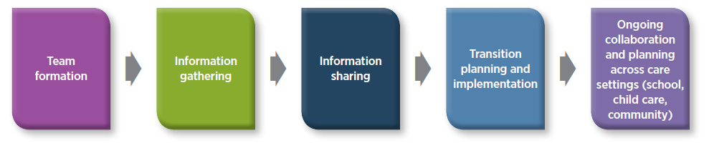
Overview of Transition Planning Process
Notes:
There are 5 phases to the transition planning process.

Slide 16
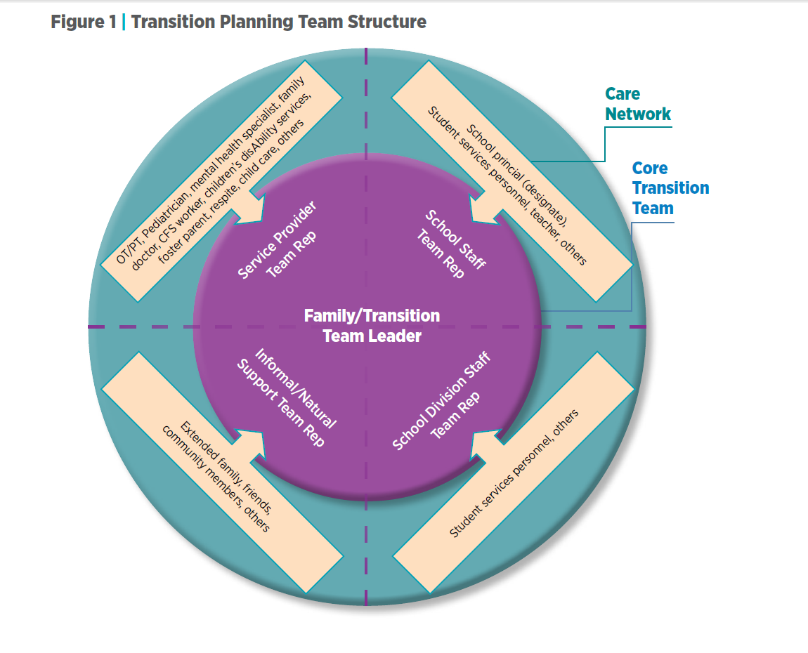
Notes:
This graphic from the Protocol represents the family’s larger care network.
Who should be represented, if at all possible?
-the transition team leader (the family or a designate or a combination of the two)
-a school division representative/student services administrator (SSA)
-one or more school representatives
-service providers (as needed for information sharing or acting as team leaders)
-informal/natural community supports (as needed to support child and family)

Slide 17

Leadership & Family Voice
the family either acts as the transition team leader...
or chooses a trusted delegate to lead or co-lead the process.
Notes:
As the family’s voice is central in the transition process, it is recommended that the family either acts as the transition team leader, or chooses a trusted delegate to lead or co-lead the process.
The delegated team leader should be a member of the child’s care network who is accessible, available to take on the task, and with whom the child has a positive relationship.

Slide 18
Transition Planning Template
  The child and family
  Play
  Cognitive/Concepts
  Communication
  Self-help
  Mobility
  Sensory
Sensory processing abilities
Social/emotional/ behavioural
Health/safety & well-being
Health care needs
Notes:
Starting on page 13 in the Protocol, there is a Transition Planning Form to help the transition team gather key information about the child that would support a successful transition.
The categories on this slide are the domains found on the form.
Each domain (except first 2) start and end with:
Please outline strengths and needs of your child related to this domain.
Describe strategies, prompts, interventions, equipment, environmental adaptations, tone of voice, etc. that are effective to support your child in this particular domain.
Some domains or questions on the form may not be applicable, and some may only need a check mark or bullet points.
Please note the Consent section for sharing of information (page 40) and the Child and Family Services section for children in care (page 41-43).

Slide 19

Proactive, Positive, Strength-based
Create a complete profile of the child
Notes:
The Transition Planning Template helps to paint a picture of the child that is strengths-based and child-centric.

Slide 20

Big Idea
Collaboration
essential for an effective plan to transition children with additional support needs into school
Notes:
The big idea throughout this Protocol is COLLABORATION!
When transition team members collaborate, we can successfully develop and implement an effective plan to transition children with additional support needs into school.

Slide 21
Extras
  Online
  Case Studies/ Vignettes
  Example of a Transition Social Story
Appendices
  A. How to Create a Transition Social Story
  B. Transition Planning Template
  C. Checklist of Tasks
Service Coordination Consent for Sharing and Releasing Personal Information and/or Personal Health Information
Notes:
The extra sections in the Protocol:
Appendices
Transition Planning Template: aligns with Protocol for Children & Youth in Care in demographics and signatures
Tips for Creating a Transition Social Story
A checklist of tasks that provides team members the steps to follow according to respective roles
Consent form for sharing information between team members
Online (on the Healthy Child Manitoba Office website):
Case Studies/Vignettes: two examples of how the transition planning process might look like.
Example of a Transition Social Story

Slide 22

Your Questions?

Slide 23
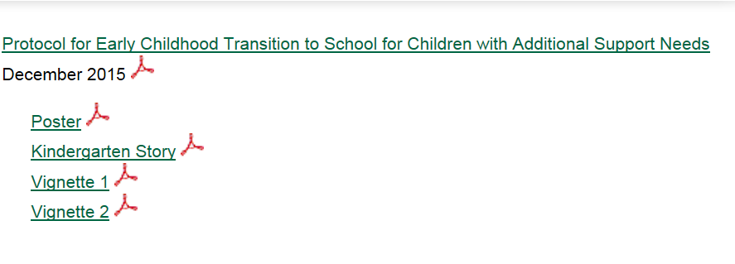

Thank you!
http://www.gov.mb.ca/healthychild/publications/index.html

